Slide 1
Before Lecture…
This Go over Proposal Handout
Portfolio – Resources: Dataset Listing and Tutorials
Next Week - 9/21 we will:
Portfolio Template (will try to set up in class)
Assignment 1 Instructions
Student Research Proposal
Proposal Due: 9/28
Next Week - Big Data Analysis, Technology Concepts, and Statistical Techniques

Slide 2
Proposal Instructions
Take a look at the handout
List the following in the Business Case Evaluation under the Methodology:
Goals – Questions
Processes – Analysis and Visualizations
Analysis - Python Statistical Libraries
Visualizations - Python Visualization Libraries
Materials – Data
Technology – Processing/Storage/etc.
E.g. Python Data Processing Libraries and Data Structures
Example:
Goal: Are patients cancerous or benign based upon their genetic makeup?
Processes:
Machine learning - mlpy, scikit-learn – k-nn/k-means classification and clustering
Visualization: matplotlib, plotly – Relationships Bubble Chart
Materials: Global Cancer Map (GCM) data which contains…..
Source: http://globalcancermap.com
Technology
Storage: Python/HDFS - pandas
Processing: Python/Spark/MapReduce – nltk/gensim

Slide 3
Commonly Used Data Sciences Tools
Library | Usage
numpy, scipy | Scientific & technical computing
pandas | Data manipulation & aggregation
mlpy, scikit-learn | Machine learning
theano, tensorflow, keras | Deep learning
statsmodels, scrapy | Statistical analysis
nltk, gensim | Text processing
networkx | Network analysis & visualization
bokeh, matplotlib, seaborn, plotly | Visualization
beautifulsoup, scrapy | Web scraping

Slide 4
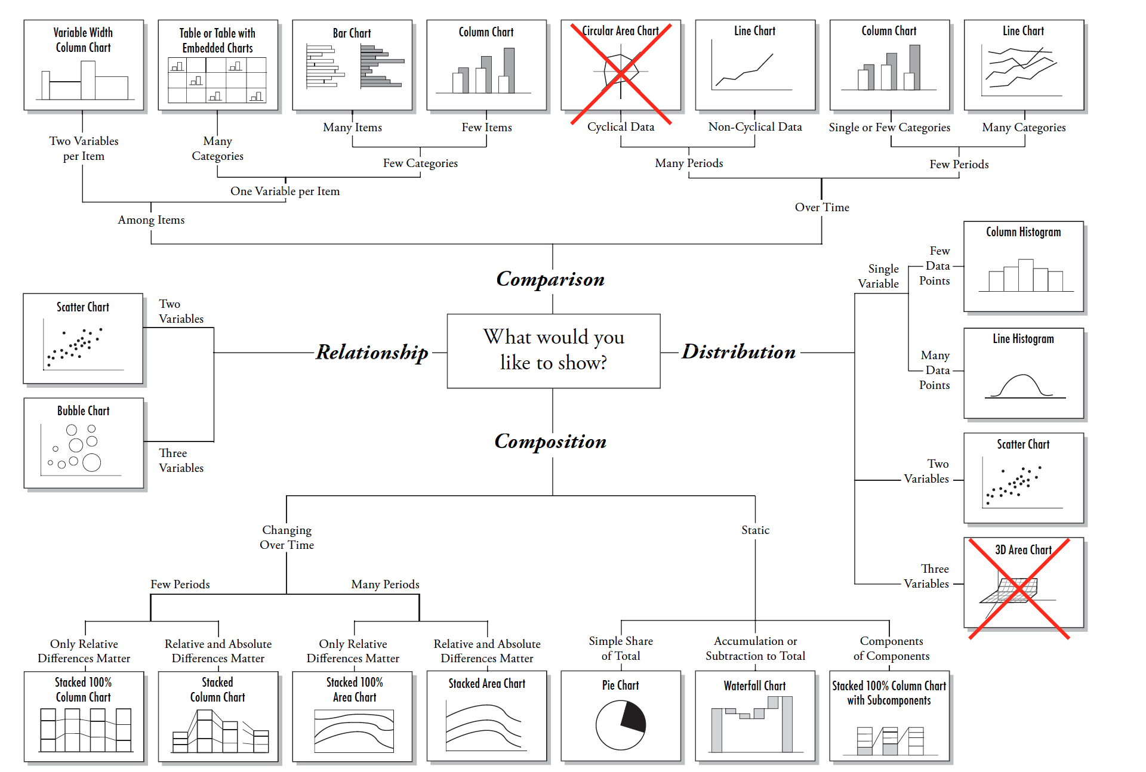
Visualization Types

Slide 5
Lecture: 3 Big Data Adoption and Planning Considerations Enterprise Technologies and Big Data Intelligence
Benjamin Harvey
Department of EMSE and CS
Data Analytics Program
The George Washington University
E-mail: bsharve@email.gw.edu
Web: https://bsharvey.github.io

Slide 6
Agenda – Planning and Considerations
Organization Prerequisites: Big Data Frameworks
Data Procurement
Privacy
Security
Provenance
Limited Real-time Support
Performance Challenges
Distinct Governance Requirements
Distinct Methodology
Clouds Big Data Analytics
Data Analytics Lifecycle (analysis vs. analytic)

Slide 7
Agenda – Enterprise Technologies and Big data Business Intelligence
Batch Processing
Online Analytical Processing (OLAP)
Stream Processing
Online Transaction processing (OLTP)
Extract Transform Load (ETL) Data
Warehouses
Data Marts
Traditional Business Intelligence (BI)
Big Data Business Intelligence (BI)
Understand the business side is key to success and this is what bringing in an Industry/Gov’t prof. allows

Slide 8
Agenda 9/21 - Big Data Analysis, Technology Concepts, and Techniques
Analysis Concepts: Models, EDA, CDA, Data Product, Statistics, Machine Learning, Data Munging,
A/B Testing,
Correlation and Regression
Heat Maps
Time Series Analysis
Network Analysis
Spatial Data Analysis
Classification and Clustering
Outlier Detection Filtering (including collaborative filtering & content-based filtering)
Natural Language Processing
Sentiment Analysis
Text Analytics

Slide 9
Why Do I Care?
Gives insight into what you need to understand before about the organization and problem space before analytic implementation has started
Complete Data Scientist understands the following:
Enterprise (Business) Architecture/Systems Engineering
Cloud Computing
Big Data
Data Science and Analytics
Business, Applications, Information, Math & Technology (e.g. Research DS vs. Enterprise DS)

Slide 10
Big Data Planning Considerations
Organization Prerequisites: Big Data Frameworks
Organization Perquisites: Big Data frameworks
Processing frameworks compute over the data in the system, either by reading from non-volatile storage or as it is ingested into the system.
Computing over data is the process of extracting information and insight from large quantities of individual data points.
Types of Big Data frameworks include:
Batch-only frameworks
Stream-only frameworks
Hybrid frameworks

Slide 11
Big Data Planning Considerations
Technology and Data Procurement
The acquisition of Big Data solutions themselves can be economical, due to the availability of free and open-source (FOSS) platforms and tools and opportunities to leverage commodity hardware.
https://hadoopecosystemtable.github.io/
External data sources include government data sources and commercial data markets.
Resources section of Portfolio
http://bsharvey.github.io

Slide 12
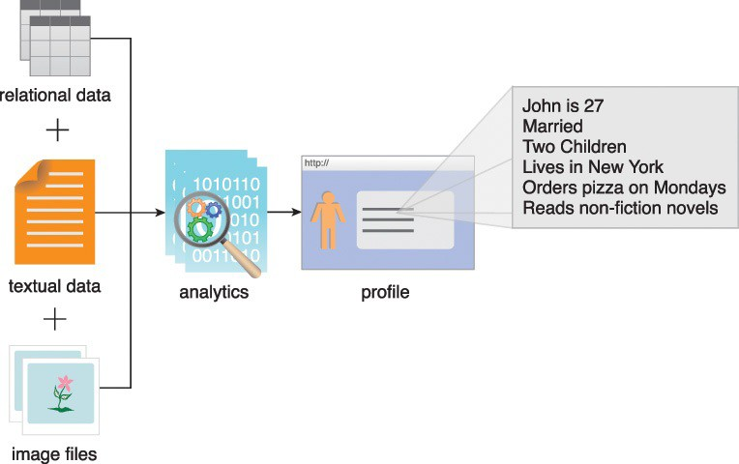
Planning Considerations - Data Privacy
Performing analytics on datasets can reveal confidential information about organizations or individuals.
Even analyzing separate datasets that contain seemingly benign data can reveal private information when the datasets are analyzed jointly
Addressing these privacy concerns requires an understanding of the nature of data being accumulated and relevant data privacy regulations, as well as special techniques for data tagging and anonymization.
Figure 3.1 Information gathered from running analytics on image files, relational data and textual data is used to create John’s profile.

Slide 13
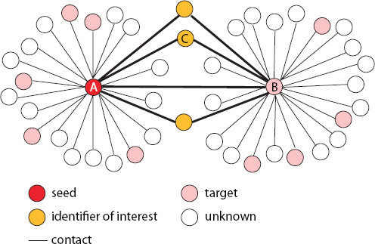
Joint Analytics and Privacy
FIGURE 3.1 A network of contacts among identifiers
https://www.nap.edu/read/19414/chapter/5#43

Slide 14
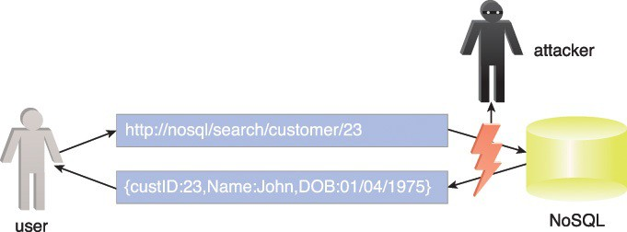
Security
Some of the components of Big Data solutions lack the robustness of traditional enterprise solution environments when it comes to access control and data security.
Securing Big Data involves ensuring that the data networks and repositories are sufficiently secured via authentication and authorization mechanisms (also based upon job role). E.g. SQL injection
Figure 3.2 NoSQL databases can be susceptible to network-based attacks.

Slide 15
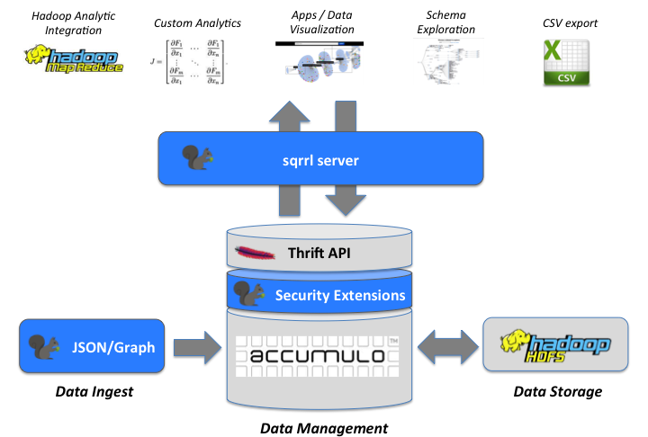


Data Security - Accumulo
Processing and Analytics
Security Layer
SOTF/Formatted Data

Slide 16

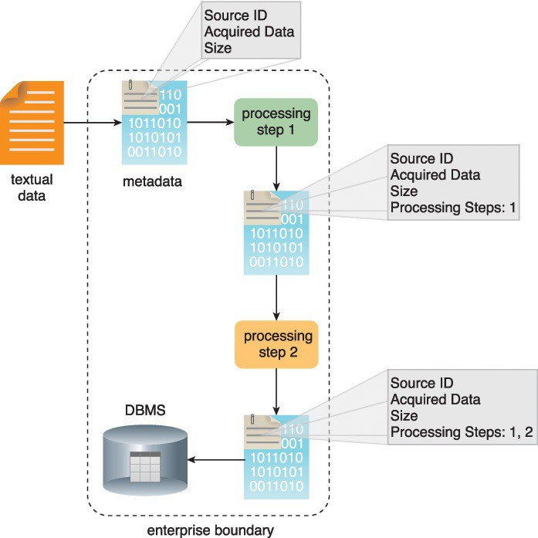
Adoption and Planning Considerations
Provenance
Provenance refers to information about the source of the data and how it has been processed.
Two aspects of provenance include:
Data Tracking and Tagging
Figure 3.3 Data may also need to be annotated with source dataset attributes and processing step details as it passes through the data transformation steps.

Slide 17
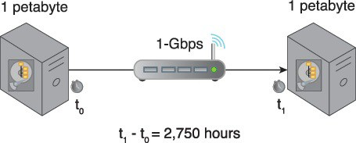
Big Data Planning Considerations
Limited Real-time Support
Dashboards and other applications that require streaming data and alerts often demand real-time or near-real-time data transmissions.
Many open source Big Data solutions and tools are batch-oriented; however, there is a new generation of real-time capable open source tools that have support for streaming data analysis.
Distinct Performance Challenges
Due to the volumes of data that some Big Data solutions are required to process in real-time, performance is often a concern.
Latency is the amount of time it takes to travel through the tube.
Bandwidth is how wide the tube is.
The amount of water flow will be your throughput
Figure 3.4 Transferring 1 PB of data via a 1-Gigabit LAN connection at 80% throughput will take approximately 2,750 hours
Notes:
Bandwidth- it refers to how wide the pipe is, not how fast. Latency: Latency is delay. For our purposes, it is the amount of time it takes a packet to travel from source to destination. Together, latency and bandwidth define the speed and capacity of a network. Throughput is the amount of data in a given amount of time.

Slide 18
Big Data Planning Considerations
Distinct Governance Requirements
Big Data solutions access data and generate data, all of which become assets of the business.
A governance framework is required to ensure that the data and the solution environment itself are regulated, standardized and evolved in a controlled manner.
Examples of what a Big Data governance framework can encompass include:
standardization of how data is tagged and the metadata within the tags
policies that regulate the kind of external data that may be acquired
policies regarding the management of data privacy and data anonymization
policies for the archiving of data sources and analysis results
policies that establish guidelines for data cleansing and filtering

Slide 19
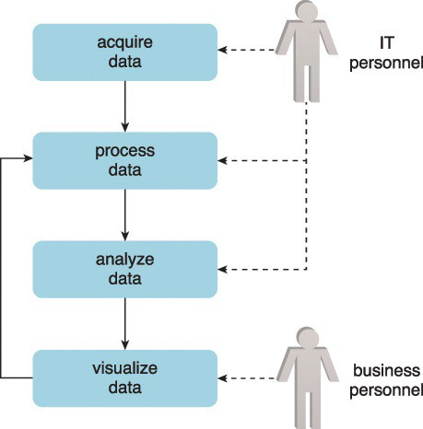
Big Data Planning Considerations
Distinct Analytic Methodology
A methodology will be required to control how data flows into and out of Big Data solutions.
It will need to consider how feedback loops can be established to enable the processed data to undergo repeated refinement.
“Human-in-the-loop”
Notes:
Evidence suggests that a variant of Pareto’s famous 80:20 leads to some of the most accurate machine learning systems to date, with 80% computer AI-driven, 19% human input, and 1 % unknown randomness to balance things out.
Human input can come in two different forms. A) Helping label the original dataset that will be fed into a machine learning model, and B) Helping correct inaccurate predictions that arise as the system goes live.
https://blog.algorithmia.com/machine-learning-with-human-in-the-loop/

Slide 20
Planning Considerations - Clouds
Clouds provide remote environments that can host IT infrastructure for large-scale storage and processing, among other things.
Common justifications for incorporating a cloud environment in support of a Big Data solution include:
inadequate in-house hardware resources
upfront capital investment for system procurement is not available
the project is to be isolated from the rest of the business so that existing business processes are not impacted (e.g. private cloud)
the Big Data initiative is a proof of concept
datasets that need to be processed are already cloud resident
the limits of available computing and storage resources used by an in-house Big Data solution are being reached
Notes:
Regardless of whether an organization is already cloud-enabled, the adoption of a Big Data environment may necessitate that some or all of that environment be hosted within a cloud.

Slide 21
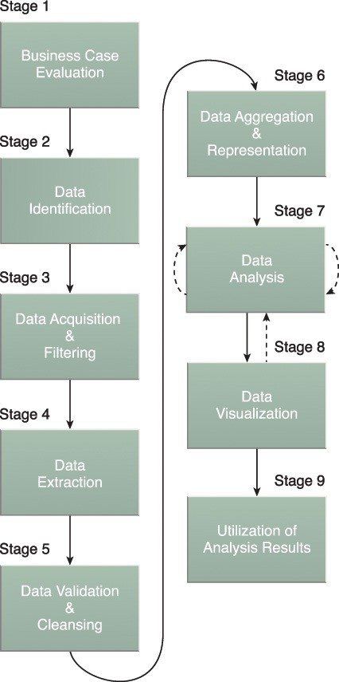
Big Data Analytics Lifecycle
Big Data analysis differs from traditional data analysis primarily due to the volume, velocity and variety characteristics of the data being processes.
To address the distinct requirements for performing analysis on Big Data, a step-by-step methodology is needed to organize the activities and tasks involved with acquiring, processing, analyzing and repurposing data:
Business Case Evaluation
Data Identification
Data Acquisition & Filtering
Data Extraction
Data Validation & Cleansing
Data Aggregation & Representation
Data Analysis
Data Visualization
Utilization of Analysis Results

Slide 22
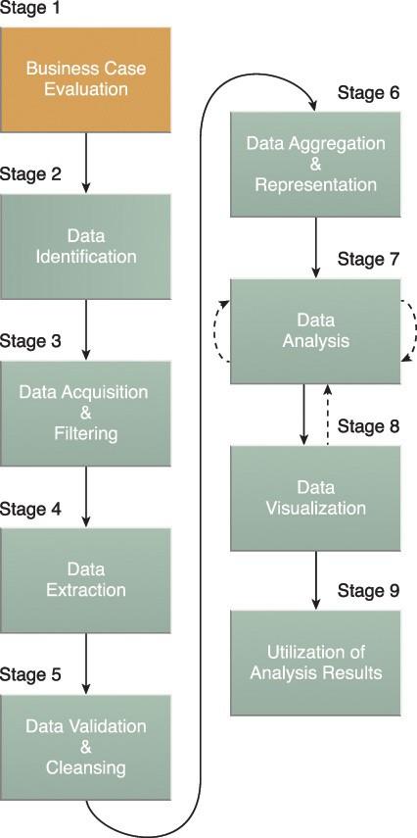
Business Case Evaluation
Each Big Data analytics lifecycle must begin with a well-defined business case that presents a clear understanding of the material processes and questions needed to conduct the analysis and how it is aligned with the goals of the organization.
The Business Case Evaluation stage requires that a business case be created, assessed and approved prior to proceeding with the actual hands-on analysis tasks (e.g. AVG).
An evaluation of a Big Data analytics business case helps decision-makers understand the business resources that will need to be utilized and which business challenges the analysis will tackle (e.g. Solutions Process).

Slide 23
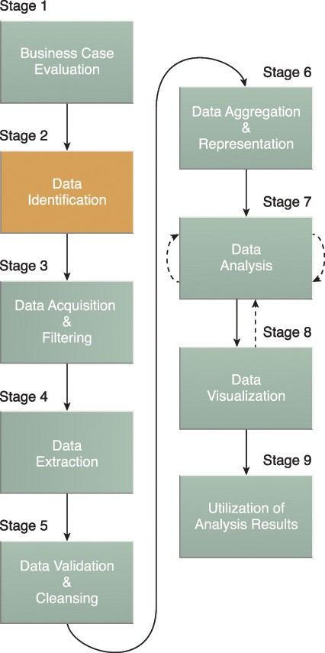
Data Identification
The Data Identification stage is dedicated to identifying the datasets required for the analysis project and their sources.
Identifying a wider variety of data sources may increase the probability of finding hidden patterns and correlations.
Depending on the business scope of the analysis project and nature of the business problems being addressed, the required datasets and their sources can be internal and/or external to the enterprise.
Notes:
For example, to provide insight, it can be beneficial to identify as many types of related data sources as possible, especially when it is unclear exactly what to look for.

Slide 24
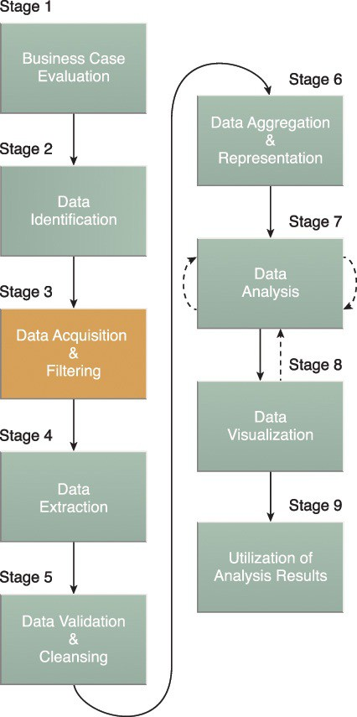
Data Acquisition & Filtering
During the Data Acquisition and Filtering stage is the gathering of data from all sources identified during the previous stage (Data Identification).
The acquired data is then subjected to automated filtering for the removal of corrupt data or data that has been deemed to have no value to the analysis objectives (e.g. NiFi).
Depending on the type of data source, data may come as a collection of files, such as data purchased from a third-party data provider, or may require API integration, such as with Twitter.
Notes:
In many cases, especially where external, unstructured data is concerned, some or most of the acquired data may be irrelevant (noise) and can be discarded as part of the filtering process.

Slide 25
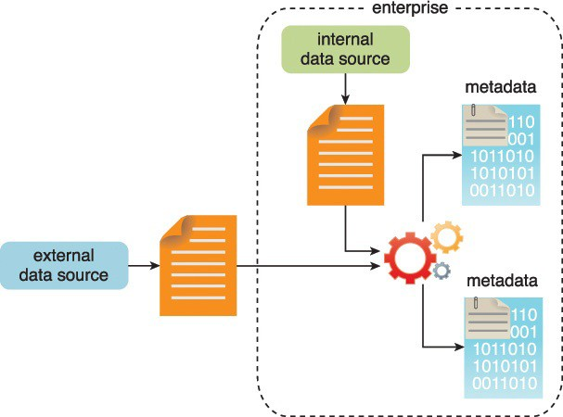
Data Acquisition & Filtering
Figure 3.10 Metadata is added to data from internal and external sources.
Notes:
It is vital that metadata be machine-readable and passed forward along subsequent analysis stages. This helps maintain data provenance throughout the Big Data analytics lifecycle, which helps to establish and preserve data accuracy and quality.
Examples of appended metadata include dataset size and structure, source information, date and time of creation or collection and language-specific information.

Slide 26
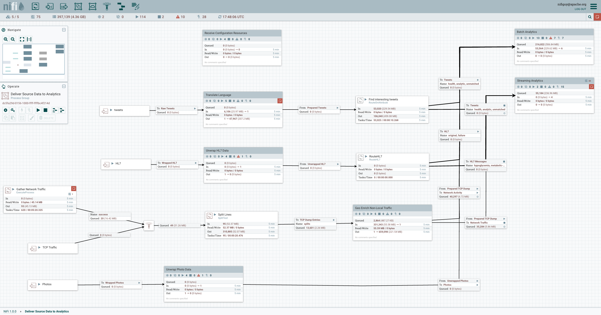

Data Acquisition and Filtering -NiFi
http://nifi.apache.org

Slide 27
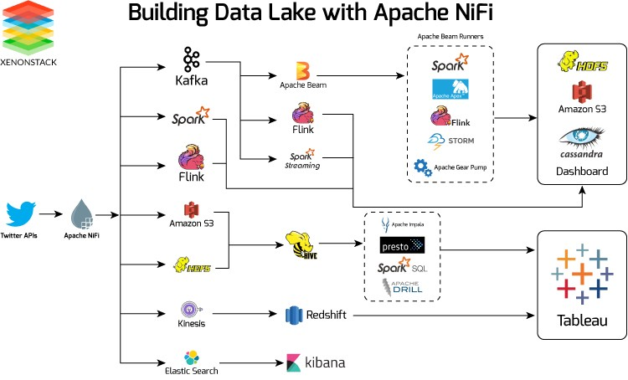
Building a Data Lake with NiFi
Xenonstack.com

Slide 28
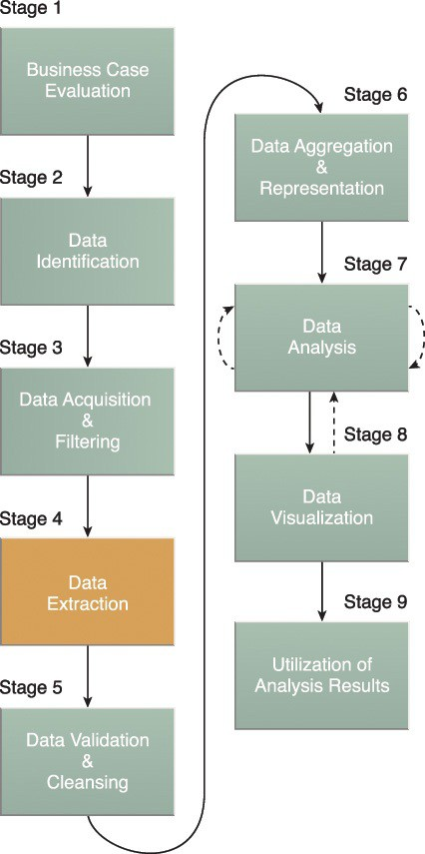
Data Extraction & Formatting
Some of the data identified as input for the analysis may arrive in a format incompatible with the Big Data solution.
The Data Extraction lifecycle stage is dedicated to extracting disparate data and transforming it into a format that the underlying Big Data solution can use for the purpose of the data analysis (e.g. Data Format Standards - SOTF).
The extent of extraction and transformation required depends on the types of analytics and capabilities of the Big Data solution
Notes:
For example, extracting the required fields from delimited textual data, such as with webserver log files, may not be necessary if the underlying Big Data solution can already directly process those files.

Slide 29
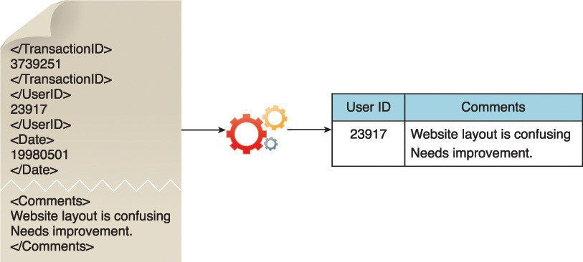
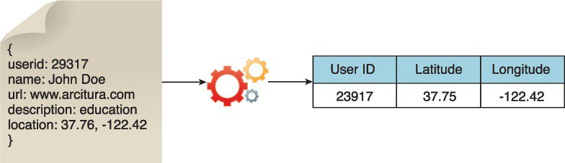
Data Extraction
Figure 3.12 illustrates the extraction of comments and a user ID embedded within an XML document without the need for further transformation.
Figure 3.13 demonstrates the extraction of the latitude and longitude coordinates of a user from a single JSON field.

Slide 30
A Prototype Spatial Object Transfer Format (SOTF)
SOTF supports multiple inheritance of feature types
SOTF supports light-weight, binary feature relationships
SOTF it was originally designed to handle complex, structured geospatial data;
it does not support methods and behaviour.
SOTF has an object-oriented schema with:
features and feature types
properties and data types
SOTF supports multiple geometric properties per feature
SOTF supports both spatial and aspatial feature types
Designed to work with both [object-]relational and object-oriented data stores
An SOTF dataset always includes an explicit schema
To support export of an SOTF dataset a data store
should provide feature identifiers that persist between exports
may provide ability to retain a previous state

Slide 31
A Prototype Spatial Object Transfer Format (SOTF)
Data supplier
Data consumer
dataset
Data supplier (with pre-defined ‘tile’ structure)
Pre-generated, stock-piled, set of SOTF datasets
Data consumer combines SOTF datasets

Slide 32
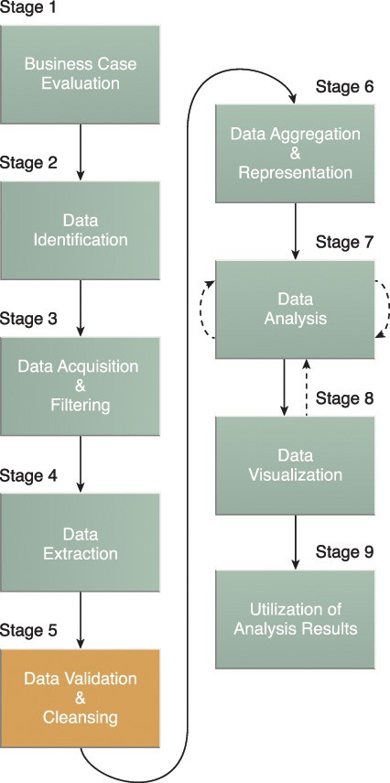
Data Validation & Cleaning
Invalid data can skew and falsify analysis results. Unlike traditional enterprise data, where the data structure is pre-defined and data is pre-validated, data input into Big Data analyses can be unstructured without any indication of validity.
This stage is dedicated to establishing often complex validation rules and removing any known invalid data.
Big Data solutions often receive redundant data across different datasets. This redundancy can be exploited to explore interconnected datasets in order to assemble validation parameters and fill in missing valid data.

Slide 33
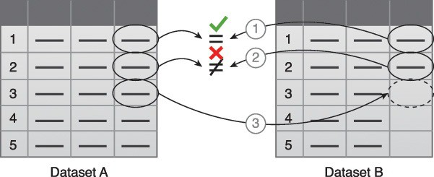
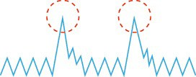
Data Validation & Cleaning
Figure 3.15 Data validation can be used to examine interconnected datasets in order to fill in missing valid data.
Abnormal/Outlier
Statically Significant
Figure 3.16 The presence of invalid data is resulting in spikes. Although the data appears abnormal, it may be indicative of a new pattern.

Slide 34
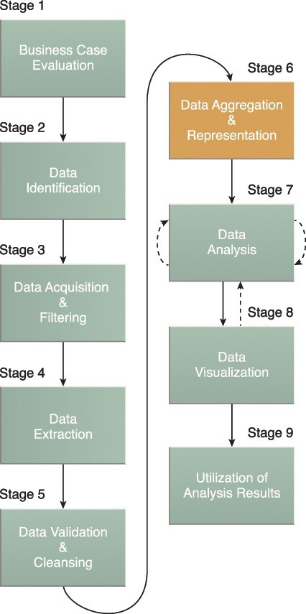
Data Aggregation & Representation
The Data Aggregation and Representation stage is dedicated to integrating multiple datasets together to arrive at a unified view.
Performing this stage can become complicated because of differences in:
Data Structure – Although the data format may be the same, the data model may be different.
Semantics – A value that is labeled differently in two different datasets may mean the same thing, for example “surname” and “last name.”
Notes:
Data may be spread across multiple datasets, requiring that datasets be joined together via common fields, for example date or ID. In other cases, the same data fields may appear in multiple datasets, such as date of birth. Either way, a method of data reconciliation is required or the dataset representing the correct value needs to be determined.

Slide 35
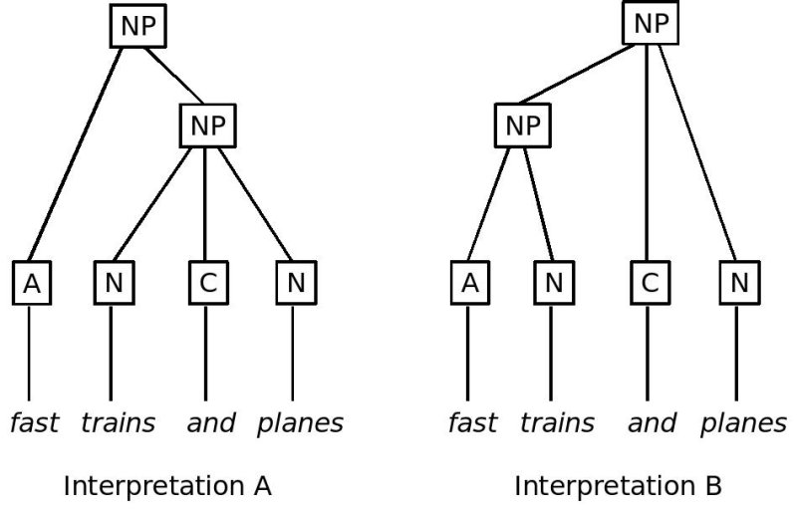
Data Aggregation & Representation

Slide 36

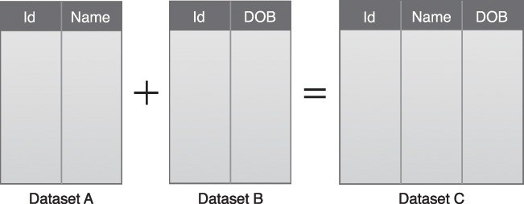
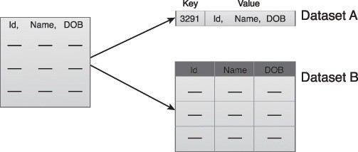
Data Aggregation & Representation
Figure 3.18 A simple example of data aggregation where two datasets are aggregated together using the Id field.
Figure 3.19 Dataset A and B can be combined to create a standardized data structure with a Big Data solution.

Slide 37
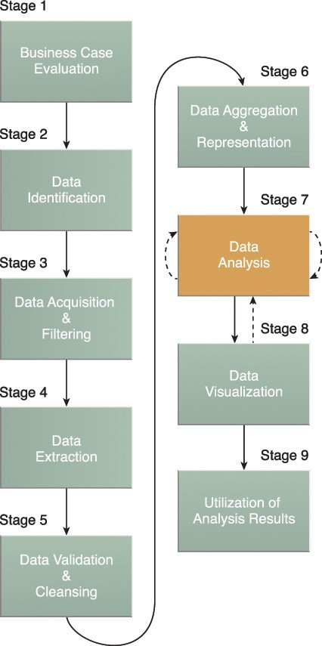
Data Analysis
The Data Analysis stage is dedicated to carrying out the actual analysis task, which typically involves one or more types of analytics.
This stage can be iterative in nature, especially if the data analysis is exploratory, in which case analysis is repeated until the appropriate pattern or correlation is uncovered.
The Exploratory Data Analysis (EDA) approach will be explained shortly, along with confirmatory analysis.
Type examples:
querying a dataset to compute an aggregation for comparison
combining data mining and complex statistical analysis techniques to discover patterns and anomalies or to generate a statistical or mathematical model to depict relationships between variables.
EDA
Notes:
Depending on the type of analytic result required, this stage can be as simple as querying a dataset to compute an aggregation for comparison. On the other hand, it can be as challenging as combining data mining and complex statistical analysis techniques to discover patterns and anomalies or to generate a statistical or mathematical model to depict relationships between variables.

Slide 38
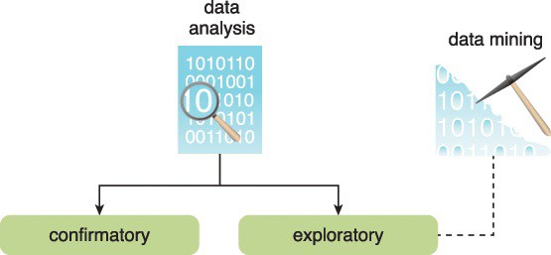
Data Analysis
Data analysis can be classified as confirmatory analysis or exploratory analysis. The latter of which is linked to data mining
Data mining is the computing process of discovering patterns in large data sets involving methods at the intersection of machine learning, statistics, and database systems.
Confirmatory Data Analysis (CDA) is a deductive approach where the cause of the phenomenon being investigated is proposed beforehand. The proposed cause or assumption is called a hypothesis.
Exploratory Data Analysis (EDA) is an inductive approach that is closely associated with data mining. No hypothesis or predetermined assumptions are generated. Instead, the data is explored through analysis to develop an understanding of the cause of the phenomenon.
Figure 3.21 Data analysis can be confirmatory or exploratory analysis.
Notes:
Deductive reasoning starts with a general theory, statement, or hypothesis and then works its way down to a conclusion based on evidence. Inductive reasoning starts with a small observation or question and works it's way to a theory by examining the related issues.

Slide 39
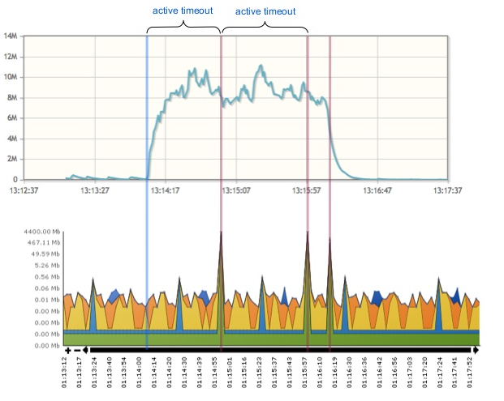
EDA and CDA
Just explore the data to see what is there.
Why this surge in netflow?
Source: sflow.com

Slide 40
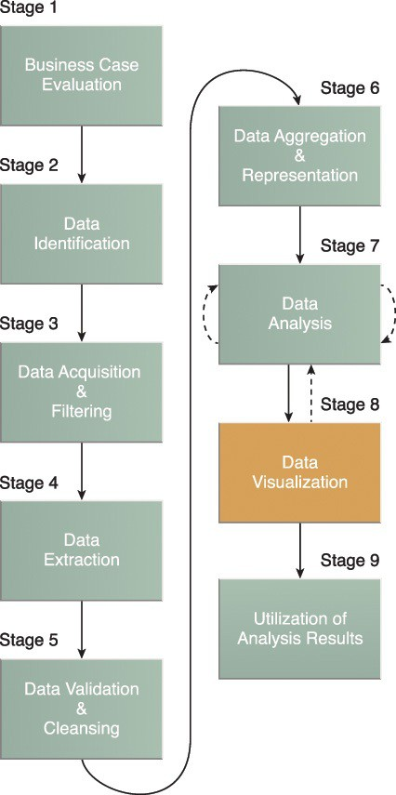
Data Visualization
The Data Visualization stage is dedicated to using data visualization techniques and tools to graphically communicate, represent and interpret the analysis results for effective interpretation by business users.
The Data Visualization stage is dedicated to using data visualization techniques and tools to graphically communicate the analysis results for effective interpretation by business users.
The results of completing the Data Visualization stage provide users with the ability to perform visual analysis, allowing for the discovery of answers to questions that users have not yet even formulated.
Notes:
The ability to analyze massive amounts of data and find useful insights carries little value if the only ones that can interpret the results are the analysts.
Business users need to be able to understand the results in order to obtain value from the analysis and subsequently have the ability to provide feedback

Slide 41
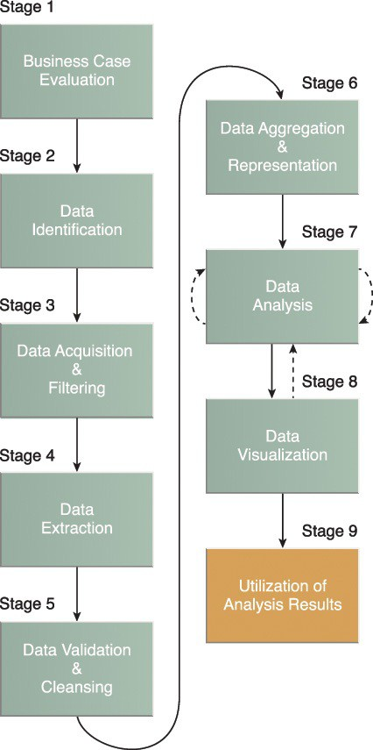
Utilization of Analysis Results
Subsequent to analysis results being made available to business users to support business decision-making, such as via dashboards, there may be further opportunities to utilize the analysis results.
The Utilization of Analysis Results stage is dedicated to determining how and where processed analysis data can be further leveraged.
Depending on the nature of the analysis problems being addressed, it is possible for the analysis results to produce “models” that encapsulate new insights and understandings about the nature of the patterns and relationships that exist within the data that was analyzed.
Notes:
A model may look like a mathematical equation or a set of rules. Models can be used to improve business process logic and application system logic, and they can form the basis of a new system or software program.

Slide 42
Enterprise Technologies and Big Data Business Intelligence
Data is collected from throughout the enterprise and warehoused in a data warehouse, analytical processing systems answer more complex queries and provide deeper insight into business operations.
It is from these data stores and processing that management gains insight into broader corporate performance and KPIs which include
Operations/Research Storage and Processing Technologies
Stream Processing
Batch Processing
Business Storage and Processing Technologies
OLAP (Vertica, Netezza, Hadoop)
OLTP-oriented databases: (Postgres, MySQL, VoltDB, Oracle),
Hybrid OLTP and OLAP: (HBase, Cassandra, MongoDB)
Extract Transform Load (ETL) Processes
Data Warehouses
Data Marts
Notes:
Big Data is often created by high-volume feeds of incoming state that remains mutable, possibly indefinitely. It's a poor fit for traditional OLTP databases due to the volume involved and it's a poor fit for analytic databases due to the emphasis on mutable state and point queries. Both types of databases are ultimately necessary because the ideal storage layout for a given data set is determined by the queries you need to execute efficiently.

Slide 43
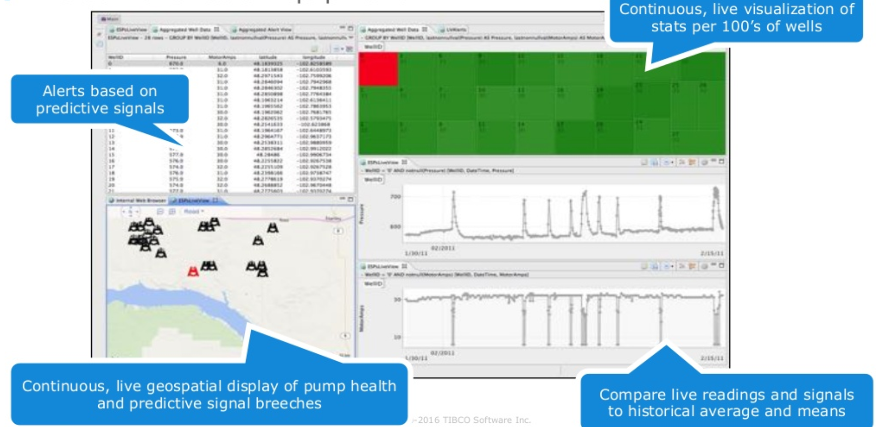
Why Streaming?
Source: Tibco.com

Slide 44
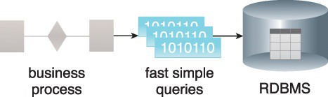
Streaming and OLTP
Streaming Processing
Under the streaming model, data is fed into analytics tools piece-by-piece. The processing is usually done in real time.
Online Transaction Processing (OLTP)
OLTP is a software system that processes transaction-oriented data. The term “online transaction” refers to the completion of an activity in real-time and is not batch-processed. OLTP systems store operational data that is normalized. This data is a common source of structured data and serves as input to many analytic processes
Figure 4.1 OLTP systems perform simple database operations to provide sub-second response times.

Slide 45
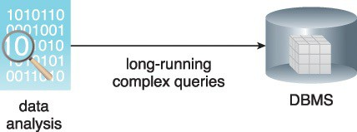
Batch and OLAP
Batch Processing
Under the batch processing model, a set of data is collected over time, then fed into an analytics system. In other words, you collect a batch of information, then send it in for processing.
Online Analytic Processing (OLAP)
Online analytical processing (OLAP) systems are used for processing data analysis queries. OLAPs form an integral part of business intelligence, data mining and machine learning processes. They are relevant to Big Data in that they can serve as both a data source as well as a data sink that is capable of receiving data. They are used in diagnostic, predictive and prescriptive analytics
Figure 4.2 OLAP systems use multidimensional databases.
Notes:
. As shown in Figure 4.2, OLAP systems perform long-running, complex queries against a multidimensional database whose structure is optimized for performing advanced analytics.

Slide 46
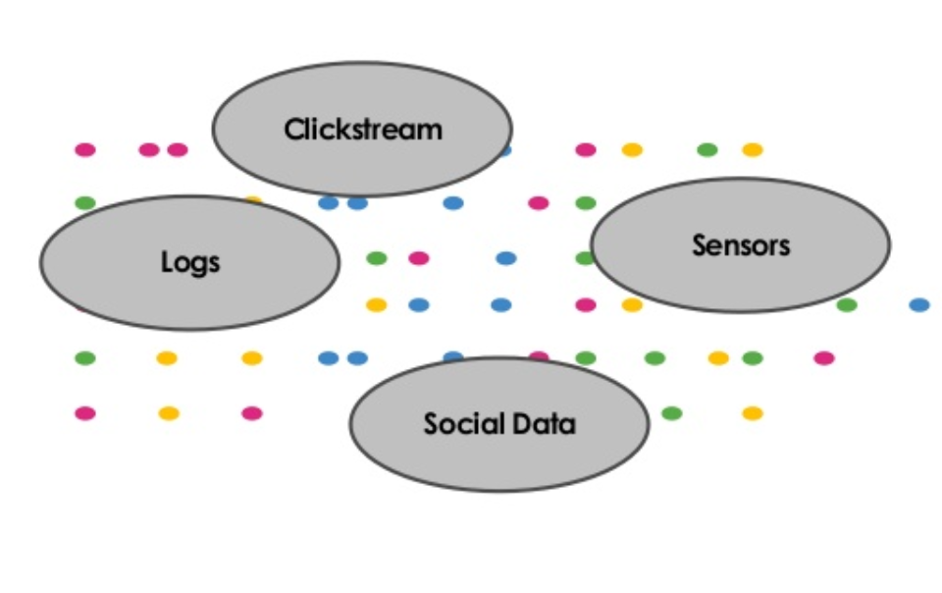
Streaming Analytics: “What Is A Stream”
Consists of pieces of data typically generated due to a change in state:
One or more identifiers
Timestamp & payload
Immutable: copy then change or delete
Typically unbounded; there is no end to the data
Batch dataset: “bounded”
Can be raw or derived
Notes:
In object-oriented and functional programming, an immutable object (unchangeable object) is an object whose state cannot be modified after it is created. This is in contrast to a mutable object (changeable object), which can be modified after it is created.

Slide 47
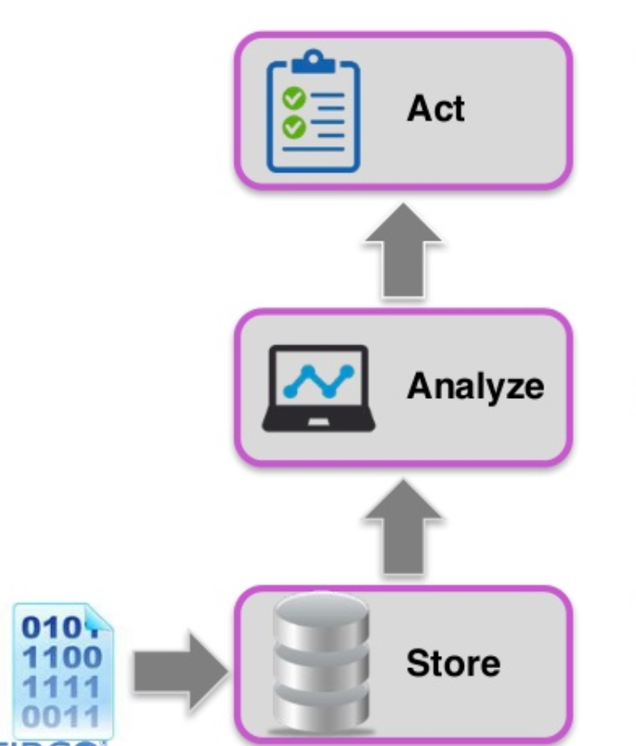
Traditional Data Processing – Request & Response
Data is collected from a variety of sources, and placed in a persistent store
Relational database
NoSQL store
Hadoop environment
Analytical processes are executed against the stored data to detect opportunities or threats
Actions are identified, delivered, and executed across various business channels

Slide 48
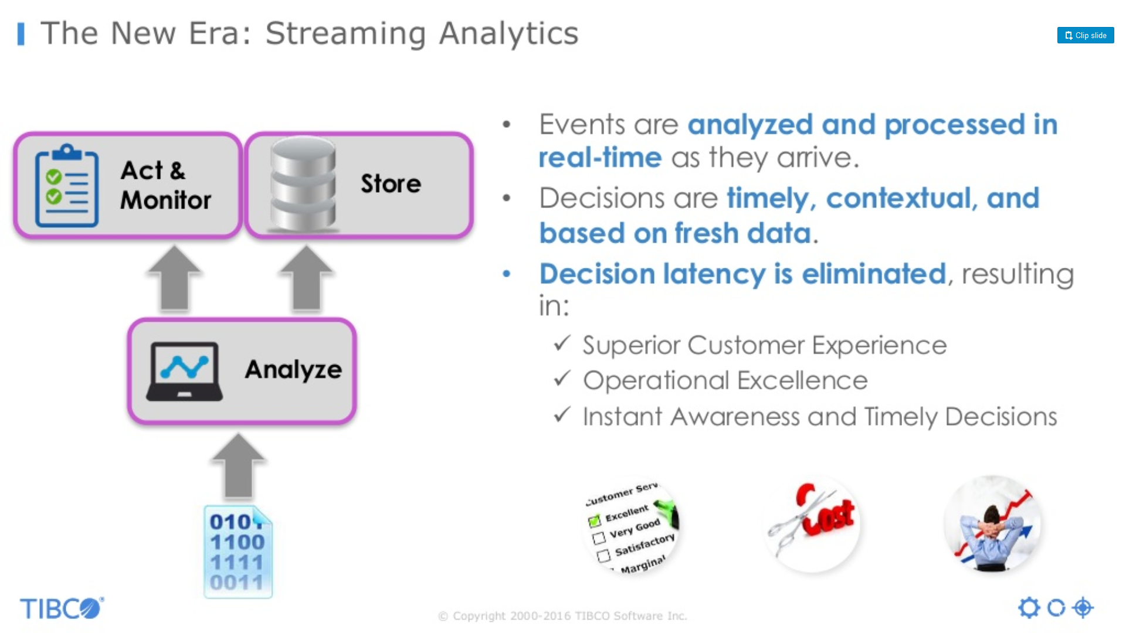
The New Era: Streaming Analytics
Events are analyzed and processed in real-time as they arrive.
Decisions are timely, contextual, and based on fresh data.
Decision latency is eliminated, resulting in:
Superior Customer Experience,
Operational Excellence,
Instant Awareness and Timely Decisions

Slide 49
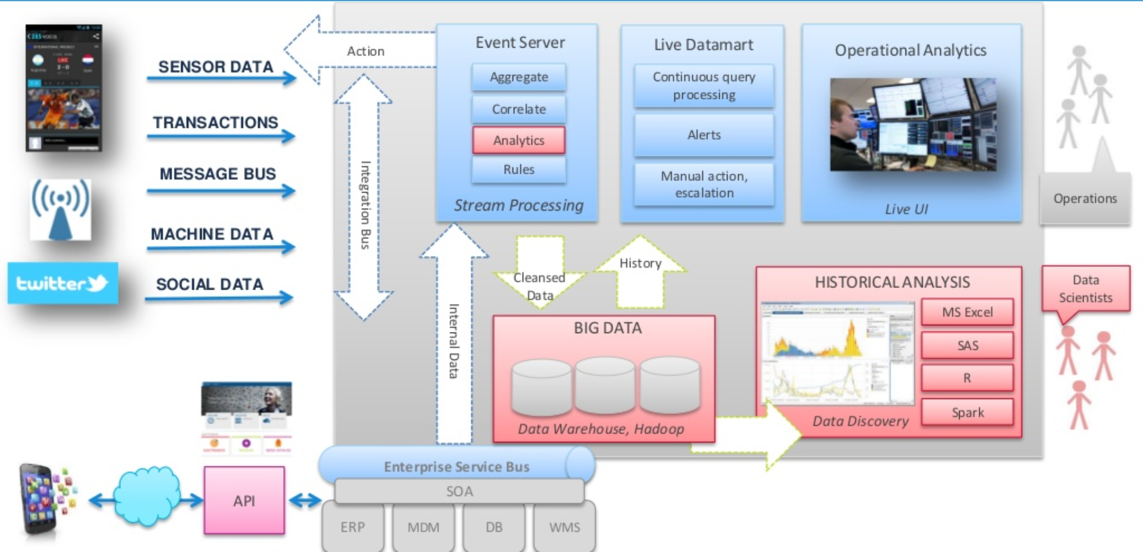
Streaming Analytics Reference Architecture
Source: tibco.com

Slide 50
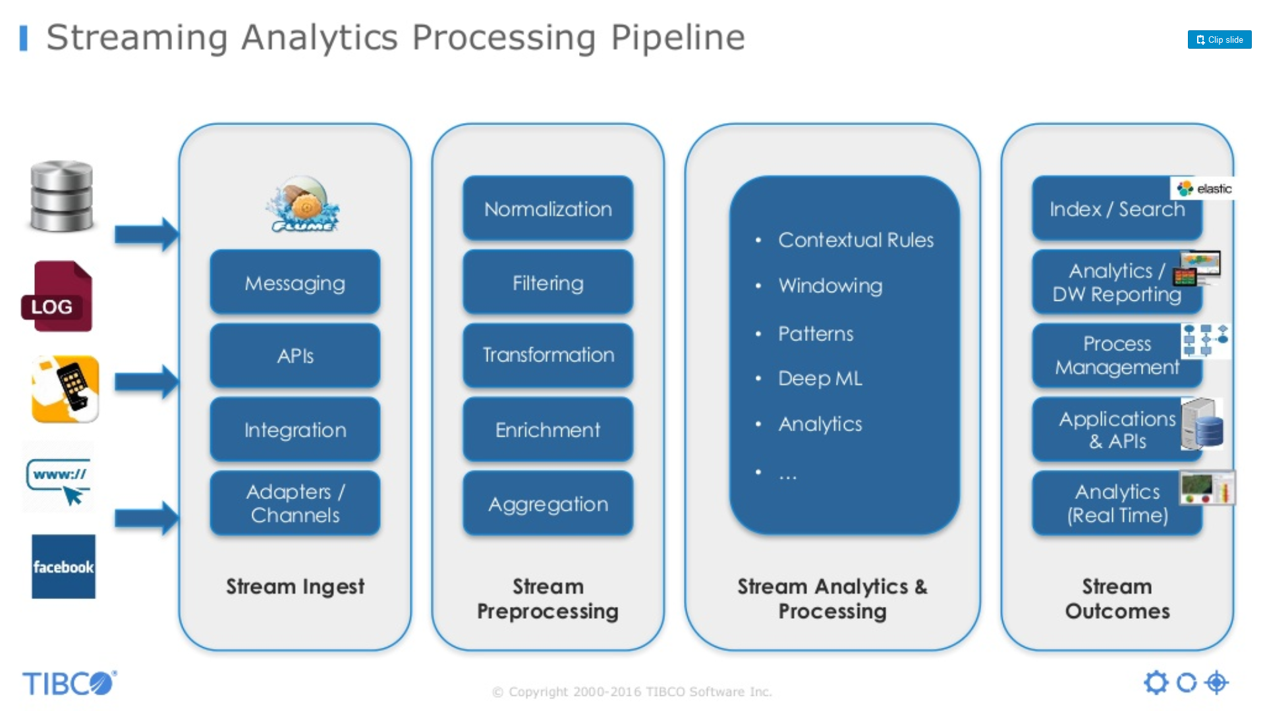
Streaming Analytics Processing Pipeline
Source: tibco.com

Slide 51
Real-time Batch Comparison
Apache Spark processes data in-memory while Hadoop MapReduce persists back to the disk after a map or reduce action, so Spark should outperform Hadoop MapReduce.
Spark needs a lot of memory. Much like standard DBs, it loads a process into memory and keeps it there until further notice, for the sake of caching.
Throughput / sec
100000s
In-Memory Computing
Interactive Query
Batch Processing
(MapReduce)
1000s
Real-Time Processing
(CEP, ESP)
DBMS
100s
ms
sec
min
hr
day
Time frame

Slide 52
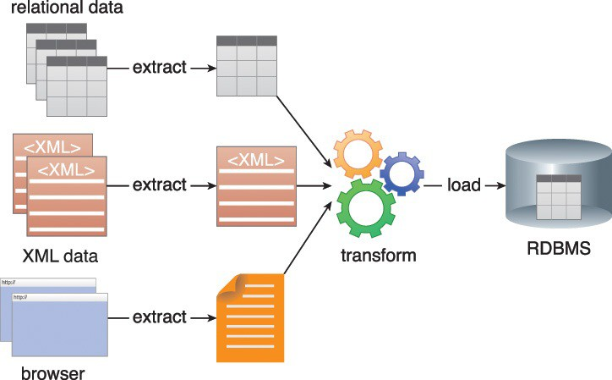
Extract Transform Load (ETL)
Extract Transform Load (ETL) is a process of loading data from a source system into a target system. The source system can be a database, a flat file, or an application. Similarly, the target system can be a database or some other storage system.
Figure 4.3 An ETL process can extract data from multiple sources and transform it for loading into a single target system.

Slide 53
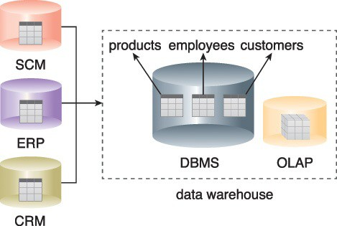
Data Warehouse
A data warehouse is a central, enterprise-wide repository consisting of historical and current data. Data warehouses are heavily used by BI to run various analytical queries, and they usually interface with an OLAP system to support multi-dimensional analytical queries.
Figure 4.4 Batch jobs periodically load data into a data warehouse from operational systems like ERP, CRM and SCM.
Notes:
E-business software systems generally fall into four categories: Enterprise Resource Planning (ERP), Customer Relationship Management (CRM), Supply Chain Management (SCM) and Sales Force Automation (SFA). ERP, CRM, SCM and SFA differ in terms of goals, functionality, users and boundary of the systems.

Slide 54
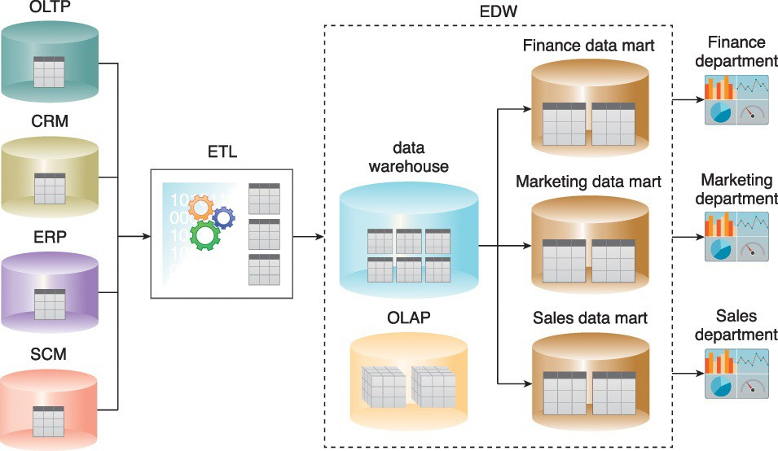
Data Marts
A data mart is a particular subset of the data stored in a data warehouse that typically belongs to a department, division, or specific line of business.
Enterprise-wide data is collected and business entities are then extracted. Domain specific entities are persisted into the data warehouse via an ETL process.
Figure 4.5 A data warehouse’s single version of “truth” is based on cleansed data, which is a prerequisite for accurate and error-free reports, as per the output shown on the right.

Slide 55
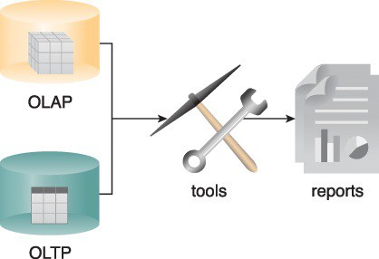
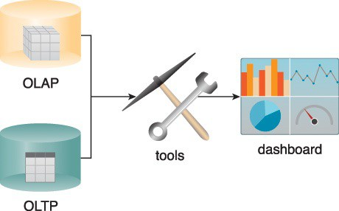
Ad-hoc Reports and Dashboards
Traditional BI primarily utilizes descriptive and diagnostic analytics to provide information on historical and current events. It is not “intelligent” because it only provides answers to correctly formulated questions through:
Ad-hoc reporting is a process that involves manually processing data to produce custom-made reports
Dashboards provide a holistic view of key business areas. The information displayed on dashboards is generated at periodic intervals in realtime or near-realtime.
Figure 4.6 OLAP and OLTP data sources can be used by BI tools for both ad-hoc reporting and dashboards.
Figure 4.7 BI tools use both OLAP and OLTP to display the information on dashboards.

Slide 56
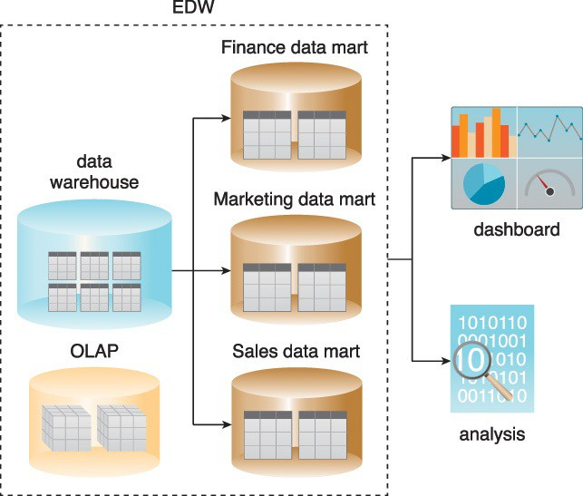
Traditional Business Intelligence
Traditional BI uses data warehouses and data marts for reporting and data analysis because they allow complex data analysis queries with multiple joins and aggregations to be issued
Figure 4.8 An example of traditional BI.

Slide 57
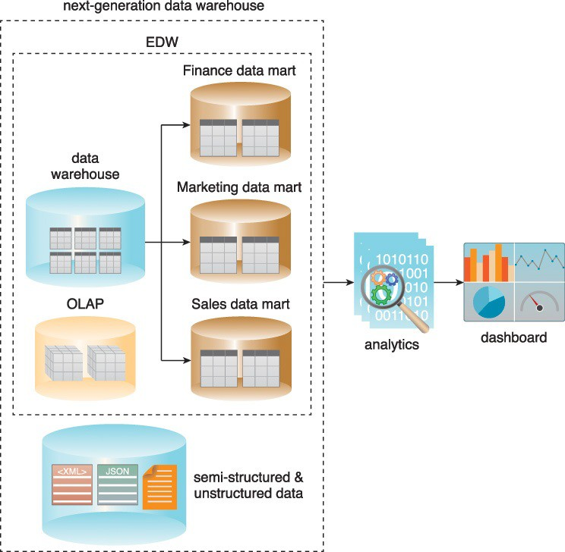
Big Data Business Intelligence
Big Data BI builds upon traditional BI by acting on the cleansed, consolidated enterprise- wide data in the data warehouse and combining it with semi-structured and unstructured data sources.
It comprises both predictive and prescriptive analytics to facilitate the development of an enterprise-wide understanding of business performance.
Figure 4.9 A next-generation data warehouse.

Slide 58
Traditional & Big Data Visualizations
Data visualization is a technique whereby analytical results are graphically communicated, interpreted, and portrayed using elements like charts, maps, data grids, infographics and alerts.
Graphically representing data can make it easier to understand reports, view trends and identify patterns.
Big Data solutions require data visualization tools that can seamlessly connect to structured, semi-structured and unstructured data sources and are further capable of handling millions of data records.
Data visualization tools for Big Data solutions generally use in-memory analytical technologies that reduce the latency normally attributed to traditional, disk-based data visualization tools.

Slide 59
Visualization Types

Slide 60
Python
Python as a Programming Language
Python is a general-purposed high-level programming language
Web development
Networking
Scientific computing
Data analytics
…

Slide 61
Python for Data Analytics
Python as a Data Analytics Tool
The nature of Python makes it perfect-fit for data analytics
Easy to learn
Readable
Scalable
Extensive set of libraries
Easy integration with other apps
Active community & ecosystem

Slide 62
Portfolio’s
iPython & Jupyter Notebook
iPython is a Python command shell for interactive computing
Jupyter Notebook (the former iPython Notebook) is a web-based interactive data analysis environment that supports iPython
20

